Slide 1
Lecture 13: Random variables and Stochastic process

Slide 2
Random variable
In probability and statistics, a random variable or stochastic variable is a variable whose value is subject to variations due to chance (i.e. randomness, in a mathematical sense). As opposed to other mathematical variables, a random variable conceptually does not have a single, fixed value (even if unknown); rather, it can take on a set of possible different values, each with an associated probability.

Slide 3
Cont.…
A random variable, usually written X, is a variable whose possible values are numerical outcomes of a random phenomenon
For example, if you roll a die, the outcome is random (not fixed) and there are 6 possible outcomes, each of which occur with probability one-sixth.
For example, if you pick a student from many students.
Roughly, probability is how frequently we expect different outcomes to occur if we repeat the experiment over and over (“frequentist” view)

Slide 4
Random variables can be discrete or continuous
Discrete random variables have a countable number of outcomes
Examples: Dead/alive, dice, counts, etc.
Continuous random variables have an infinite continuum of possible values.
Examples: blood pressure, weight, the speed of a car, the real numbers from 1 to 6.

Slide 5
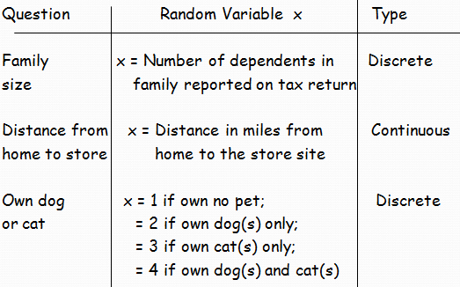
Random Variables - Examples

Slide 6
Probability Distribution
A probability distribution is an assignment of probabilities to each distinct value of a random variable or to each interval of values of a continuous random variable.
The sum of all assigned probabilities must be one.

Slide 7
Probability distribution for the rolling of an ordinary die
x P(x)
1 1/6
2 1/6
3 1/6
4 1/6
5 1/6
6 1/6

Slide 8
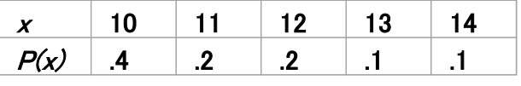
Practice problems
The number of ships to arrive at Chittagong terminal on any given day is a random variable represented by x. The probability distribution for x is:
Find the probability that on a given day:
exactly 14 ships arrive
at least 12 ships arrive
at most 11 ships arrive
Notes:
p(x=14)= .1; p(x>=12)= (.2 + .1 +.1) = .4; p(x≤11)= (.4 +.2) = .6

Slide 9
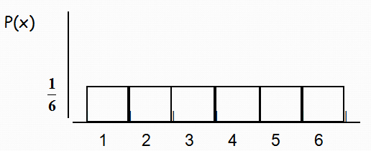
Probability Histogram

Slide 10
Mean of a Probability Distribution
μ is called the mean or expected value of the probability distribution

Slide 11
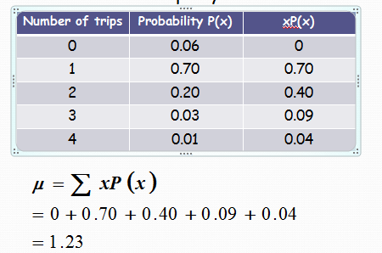
The probability distribution shown represents the number of trips of five nights or more that American adults take per year. Find the mean.

Slide 12
Standard Deviation of a Probability Distribution
is called the standard deviation
of the probability distribution

Slide 13
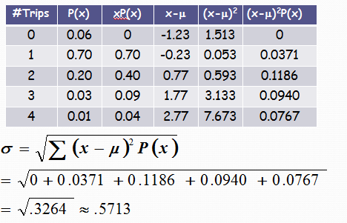
The probability distribution shown represents the number of trips of five nights or more that American adults take per year. Find the standard deviation.

Slide 14
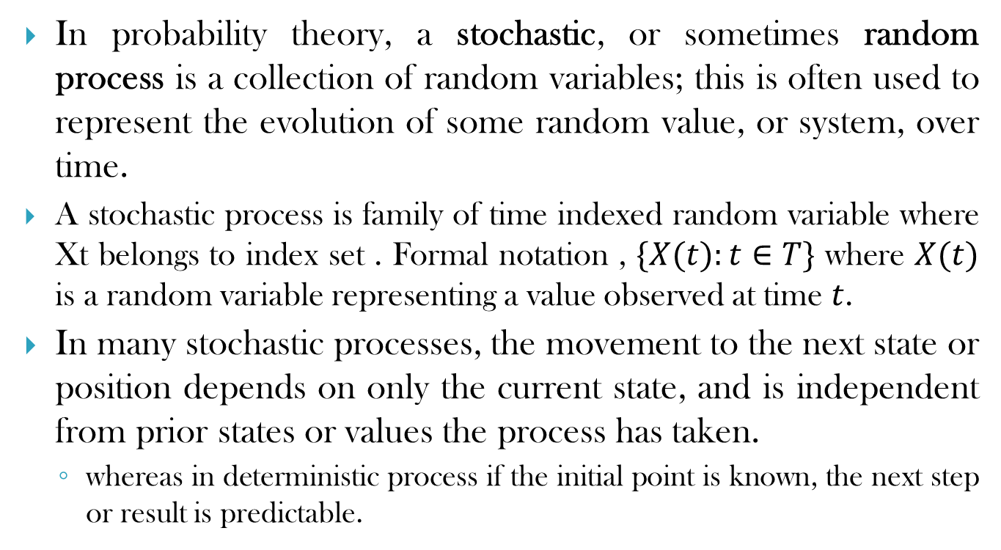
Stochastic process
In probability theory, a stochastic, or sometimes random process is a collection of random variables; this is often used to represent the evolution of some random value, or system, over time.
A stochastic process is family of time indexed random variable where Xt belongs to index set . Formal notation , $\{X(t):t∈T\}$ where $X(t)$ is a random variable representing a value observed at time $t$.
In many stochastic processes, the movement to the next state or position depends on only the current state, and is independent from prior states or values the process has taken.
whereas in deterministic process if the initial point is known, the next step or result is predictable.

Slide 15
Cont..
Familiar examples of stochastic processes include
stock market and exchange rate fluctuations;
signals such as speech; audio and video;
medical data such as a patient's EKG, EEG, blood pressure or temperature; and
random movement such as Brownian motion or random walks.

Slide 16
Example
Reaching your place of work from your home. Let us say there are three different routes do this, all of them equal in distance/traffic congestion/safety. And also let us say these routes intersect at various points before you reach your office. By this I mean, you can switch between the routes and end-route.
you have three choices [A,B,C]. You may pick any of them with probability 1/3. Say you pick route A
at each intersection, you have more possibilities: stay on route A, switch to route B or switch to route C.
The final route sequence you will take to reach the office (home-->A, A, B, C, A, A, C -->office) is not "deterministic"
Notes:
In this simplistic example, your end point (the office) is deterministic, but your route sequence is a stochastic process.

Slide 17
Types of stochastic process
Stochastic process is classified into discrete and continuous, but four categories on the basis of state space and time space
Discrete time , Discrete state space
Discrete time , Continuous state space
Continuous time , Discrete state space
Continuous time, Continuous state space

Slide 18
Example
Discrete time, Discrete state space : number of accidents at 9 pm, 10 pm, 11 pm etc.
Continuous –time ,Discrete state space : Number of accidents on a highway at an interval of time say 9 pm to 10 pm.
Discrete time ,continuous state space: age of people in a city at a particular year say 2001, 2002, 2003 etc.
Continuous time , Continuous state space: age of people from March 2013 to march 2014.

Slide 19
Examples/applications of stochastic processes
Bernoulli process
Random walk
Wiener process
Poisson process
Markov processes and chains

Slide 20
References
https://www.quora.com/What-is-a-random-variable
https://www.quora.com/What-is-a-stochastic-process-What-are-some-real-life-examples
Athanasios Papoulis, S. Unnikrishna Pillai-Probability, Random Variables and Stochastic Processes-McGraw-Hill Europe (2002)

